Slide 1

Presented by:-
S.Durga prasad
P.Charan
B.Srivardhan
G.Padhmaja
A.Sai prasanna

Slide 2

PART 1 : BRAND STUDY, COMPITITOR ANALYSI& BUYERS’S/ AUDIENCE’S PERSONA RESEARCH BRAND: “The core brand positioning is quality, trust, and innovation. Our product portfolio has grown such that today we have offerings from breakfast to dinner, and consumers look to us for quality dairy products that are central to their daily diet,” MISSION/VALUES: Mother Dairy has a diverse and welcoming workplace wherein values of trust, transparency, unquestionable commitment to quality, single-minded focus on excellence and respect for individual are simply a way of life.

Slide 3

Mother Dairy (Unique selling preposition): It is a well-known dairy company in India that offers a variety of dairy products and has several unique selling propositions (USPs) that set it apart from competitors. Here's a short note on some of the key USPs of Mother Dairy Quality Assurance: Mother Dairy is committed to providing high-quality and safe dairy products. They have stringent quality control measures in place, from sourcing milk to the final product, ensuring that consumers get the best quality. Wide Product Range: Mother Dairy offers a wide range of dairy products, including milk, curd, butter, cheese, ice cream, and more. This extensive product line caters to various consumer needs and preferences. Hygienic Processing: The company takes pride in its hygienic and state-of-the-art processing facilities. This not only ensures product safety but also maintains the freshness and taste of their dairy offerings.

Slide 4

Smart goals:- Specific: Increase sales revenue in the ice cream segment. Measurable: Achieve a 10% increase in ice cream sales by the end of the fiscal year. Achievable: Launch a new range of ice cream flavours and expand distribution channels. Relevant: Increasing sales revenue aligns with the company's growth strategy. Time-bound: Achieve the 10% increase within the fiscal year.
KPI’S:- Milk Procurement Volume: This KPI tracks the volume of milk sourced from farmers. It's essential for ensuring a consistent supply of milk for production. Production Yield: Measures the quantity of dairy products produced from a given volume of milk. This KPI is important for optimizing production efficiency. Quality Control Metrics: These can include KPIs such as the number of product recalls, customer complaints related to product quality, and adherence to quality standards. Sales Revenue: Measures the total revenue generated from the sale of dairy products, broken down by product category (e.g., milk, cheese, ice cream, etc.). Market Share: Measures the company's share of the dairy product market in specific regions or categories, providing insights into its competitive position.

Slide 5
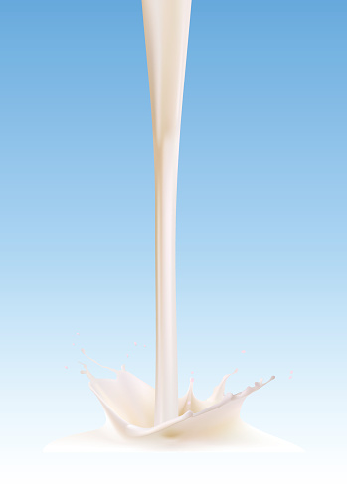
BUYER’S/AUDIENCE PERSONA :-
Buyer personas are semi-fictional representations of a company's ideal customers. Creating buyer personas helps businesses like Mother Dairy better understand and target their customers, tailor their marketing strategies, and develop products and services that meet specific customer needs. Here's a short note on potential buyer personas for Mother Dairy

Slide 6
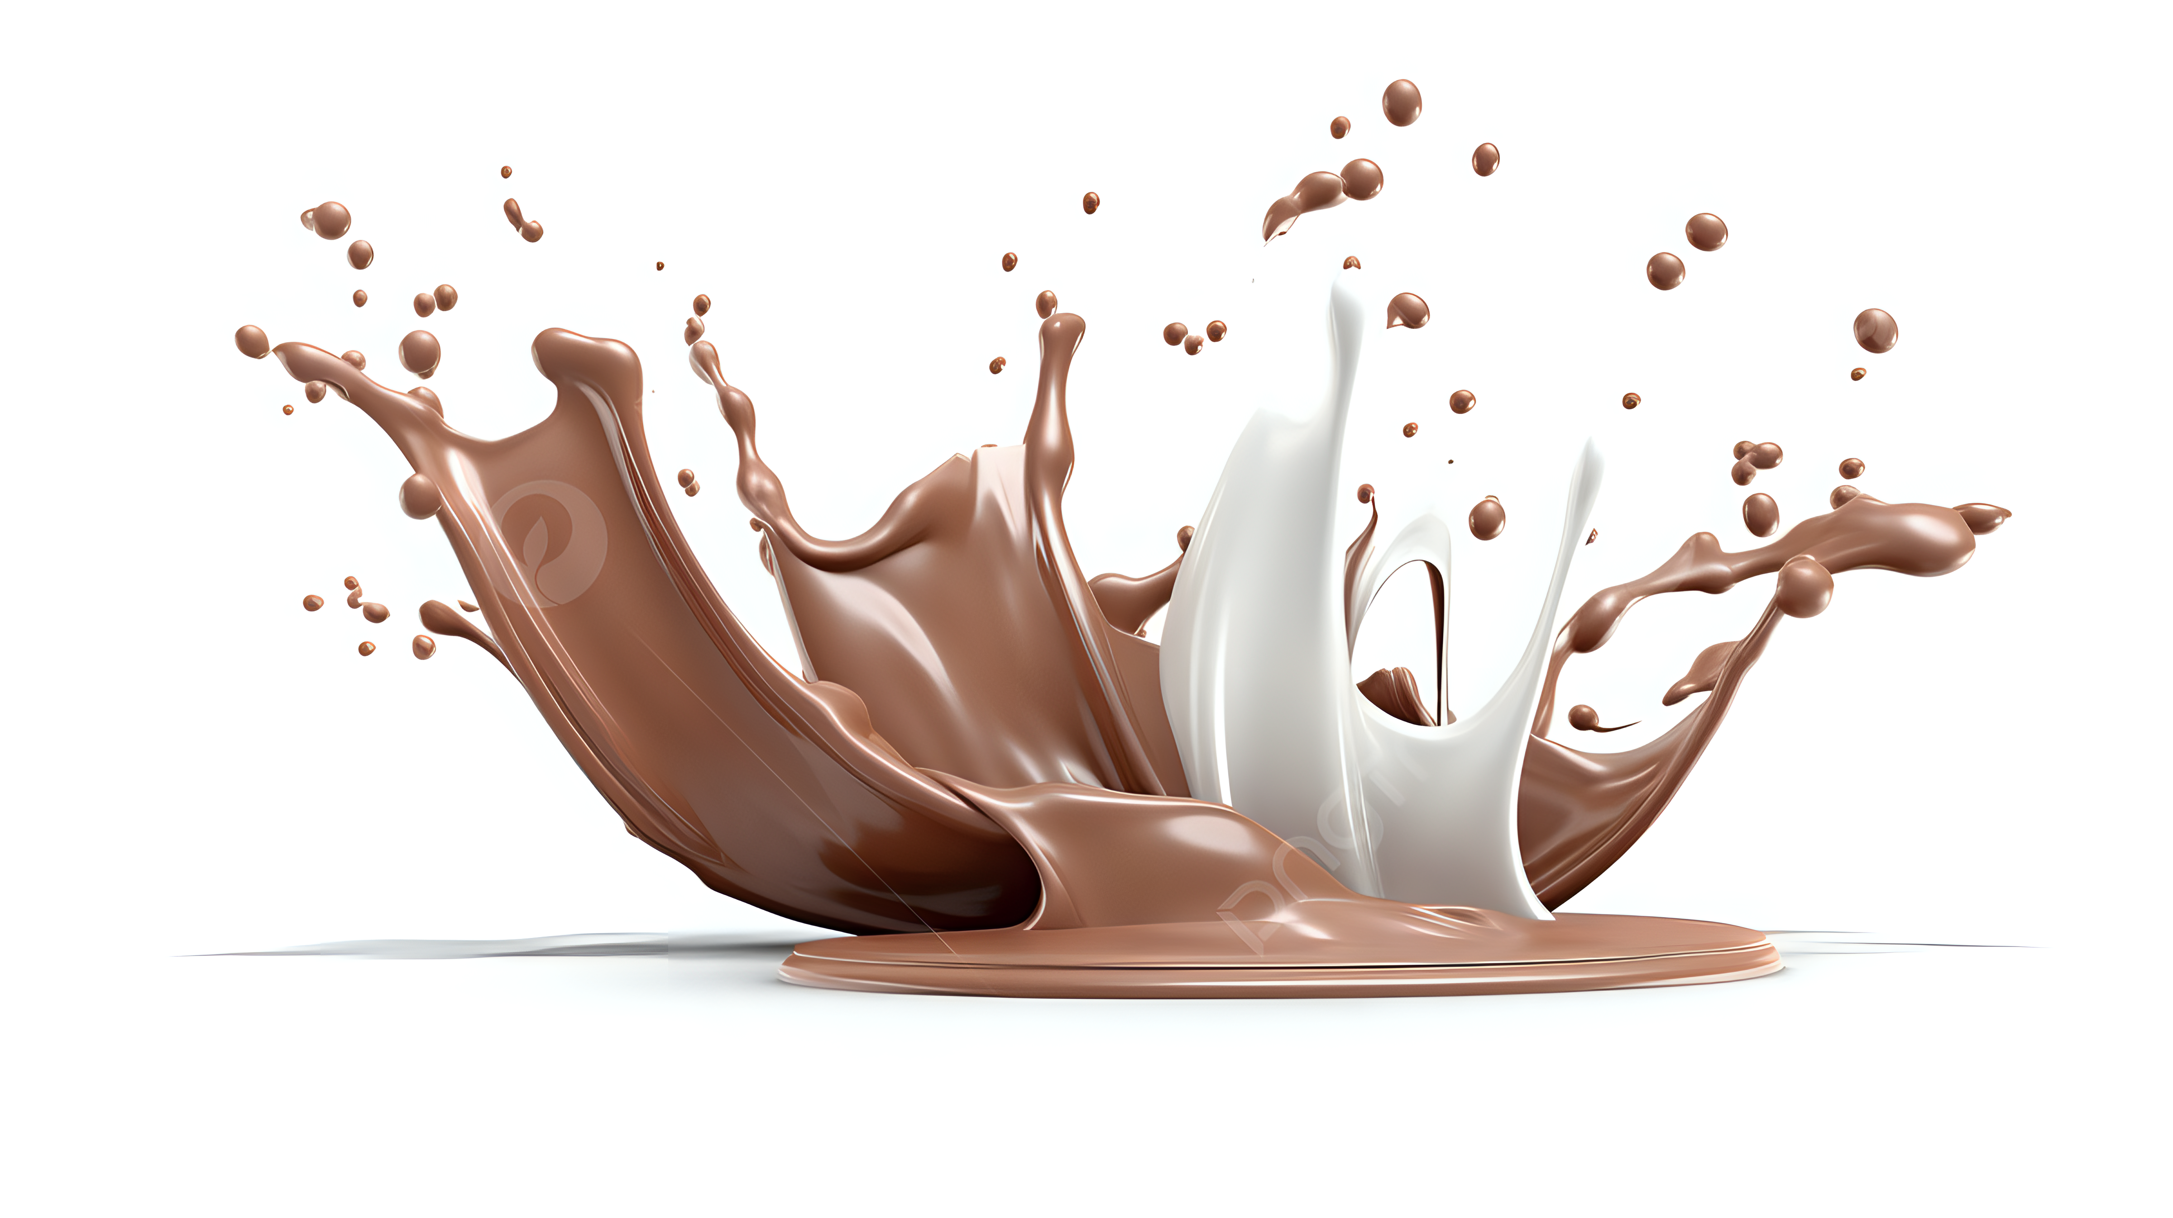
COMPETITOR ANALYSIS:-
COMPITETORS | STRENGTH | WEEKNESS | OPPURTUNITES | THREATS
Akshayakalpa |  | Compared to larger dairy competitors, Akshayakalpa's product range is relatively limited, potentially limiting its customer base. | Leveraging online sales channels could help reach a wider audience, especially in urban areas. | Economic downturns may lead consumers to prioritize cost over organic choices, affecting sales.
Godrej Agrovet | The Godrej name is well-established and trusted in India, contributing to brand recognition and customer trust. | The industry is subject to evolving and often stringent regulations, which may impact production and marketing strategies. | Leveraging technology and data analytics can enhance supply chain efficiency and customer insights. | Market price fluctuations for agricultural commodities can affect the company's revenues.
Dodla Dairy | Dodla Dairy has an integrated supply chain from procurement to processing and distribution, ensuring control over product quality and consistency. | The Indian dairy market is highly competitive, with both established and new players vying for market share. | Exploring international markets for dairy exports can tap into growing global demand for dairy products. | Volatility in milk procurement prices and changing input costs can impact the company's profitability.
Akshayakalpa's commitment to organic farming practices and sustainable dairy production resonates with environmentally-conscious consumers.

Slide 7
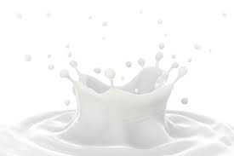
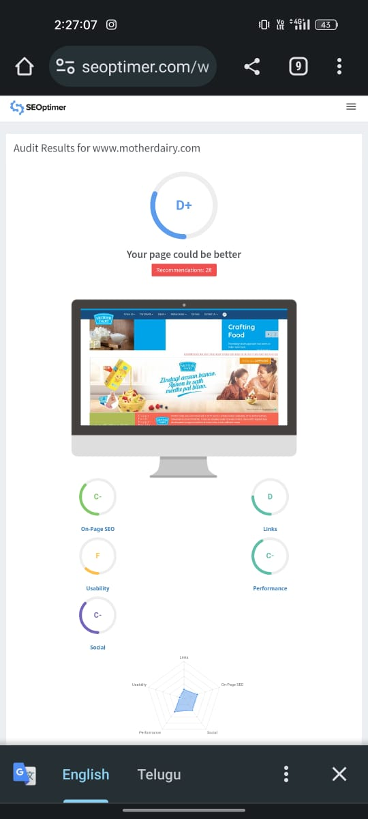
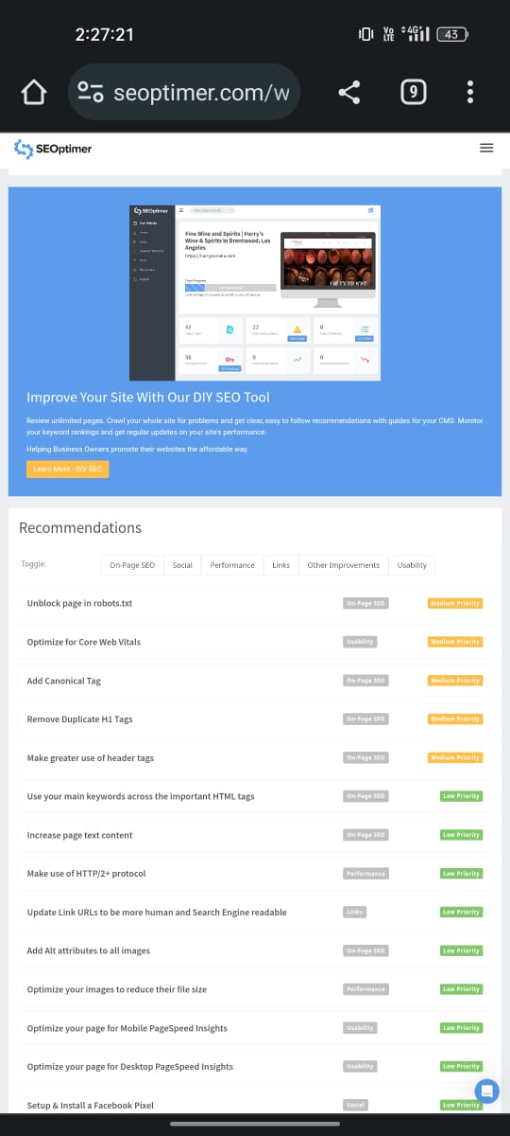
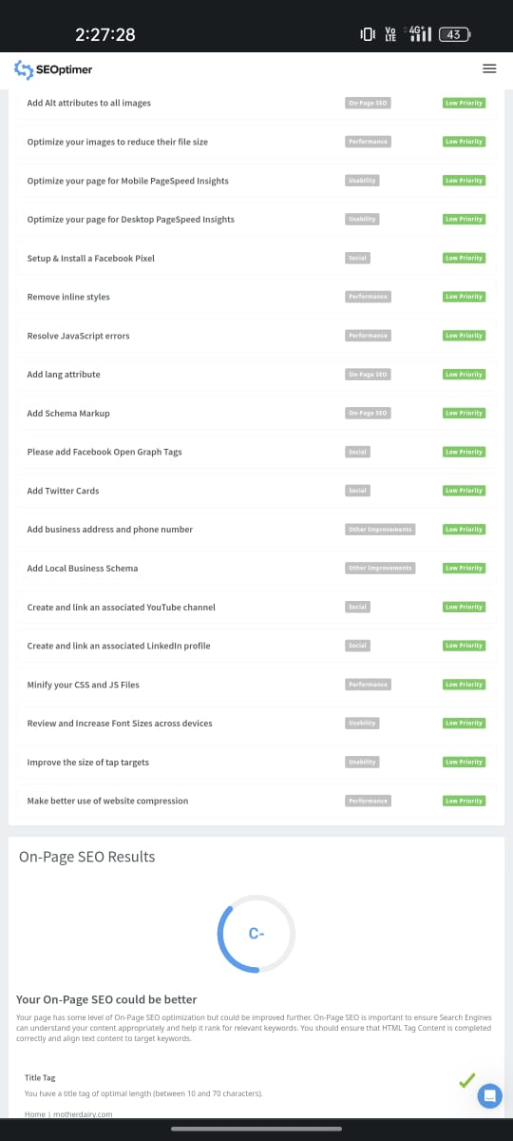
SEO AUDIT:-

Slide 8
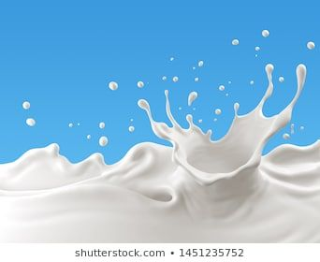
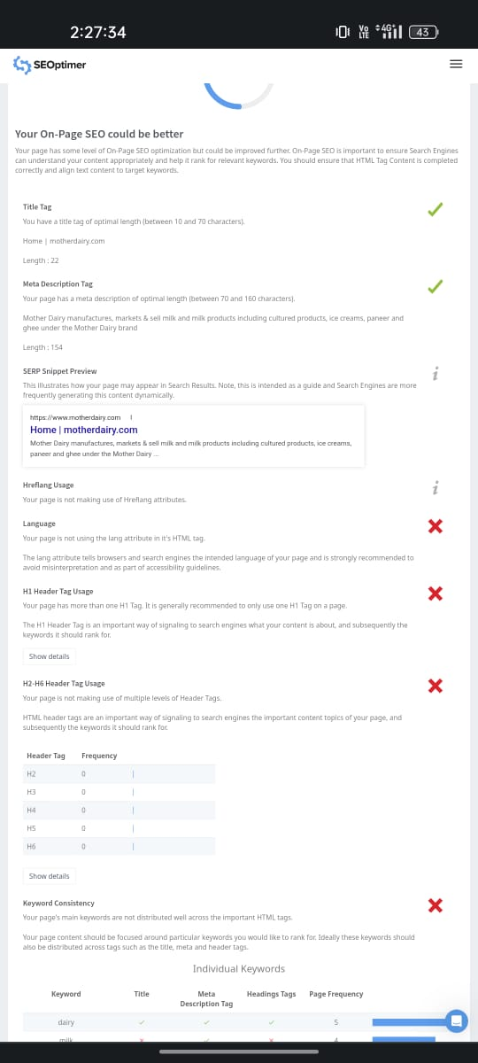
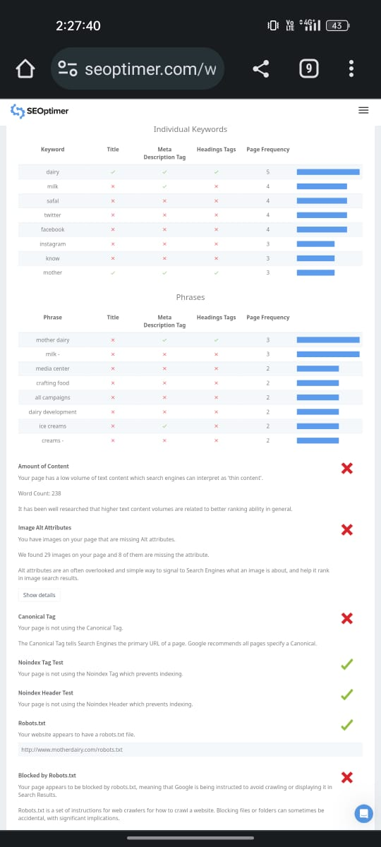
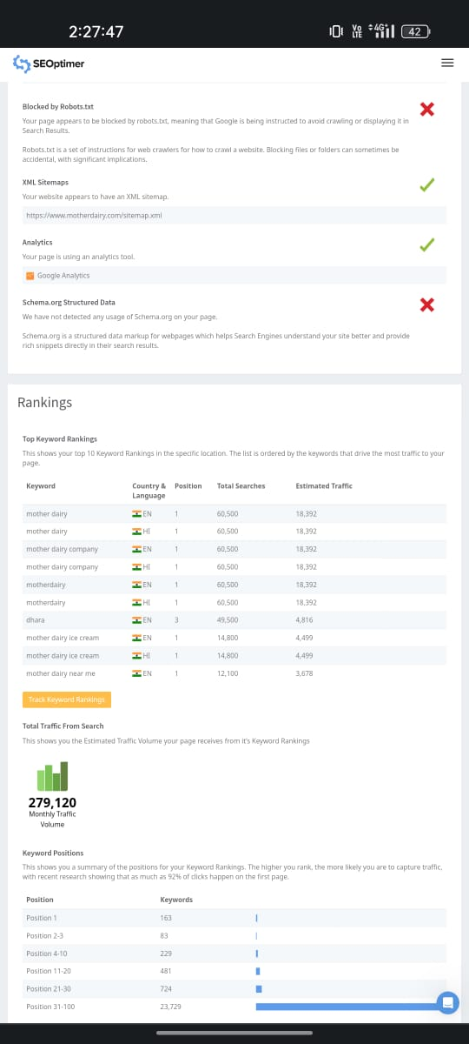

Slide 9

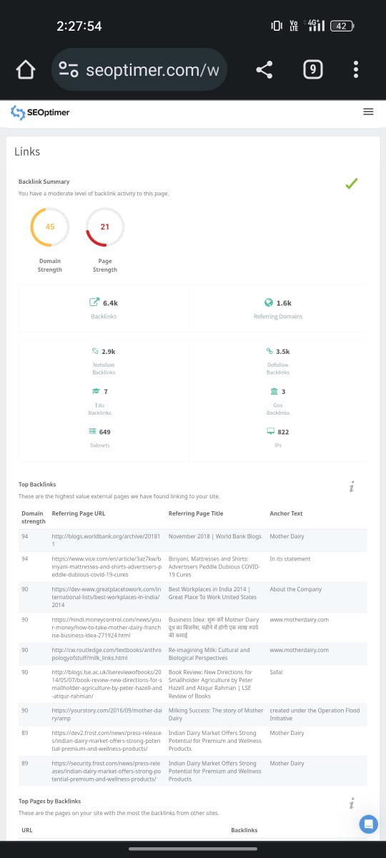
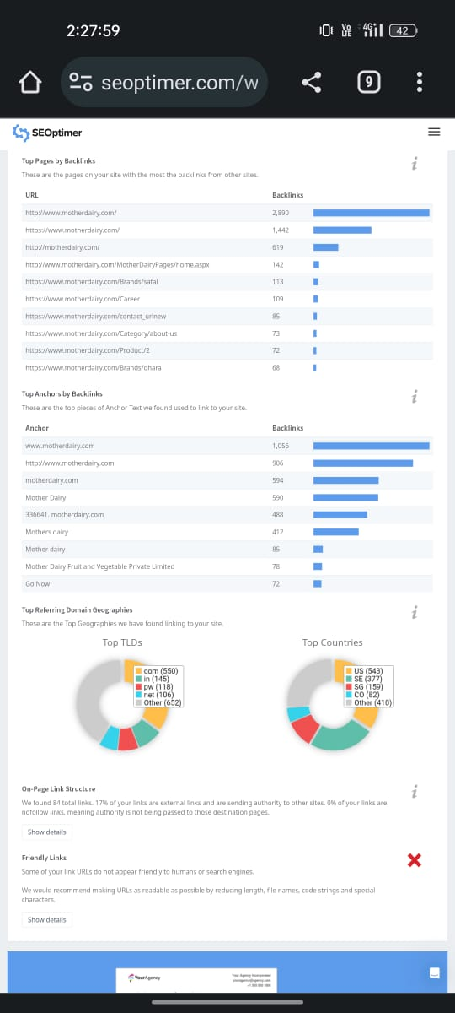
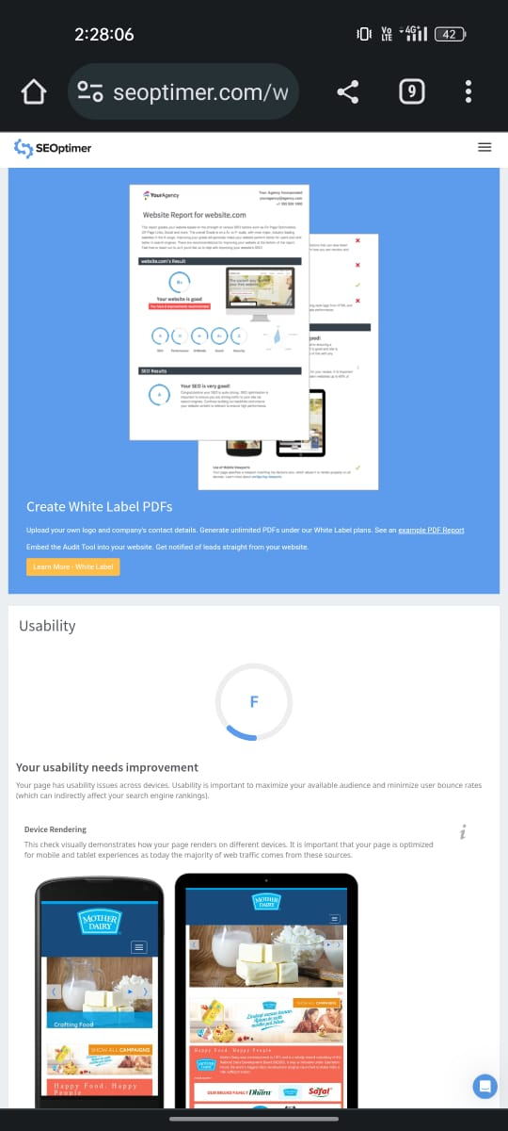

Slide 10
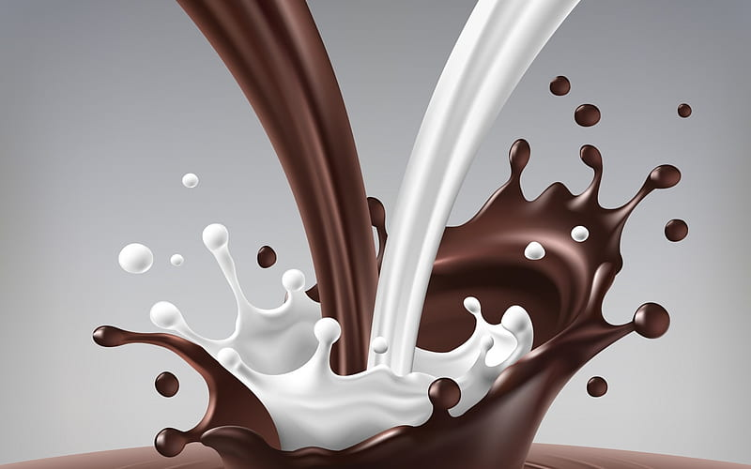
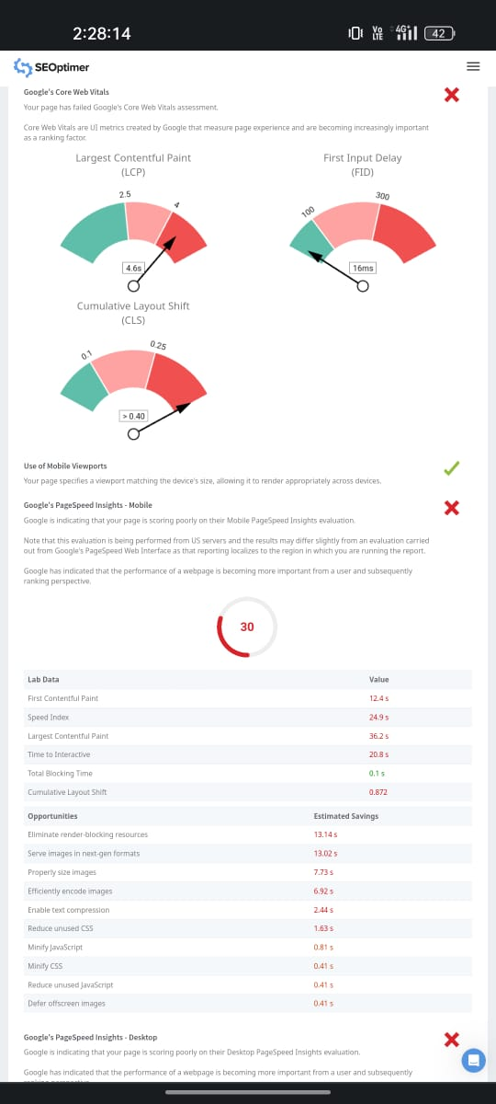
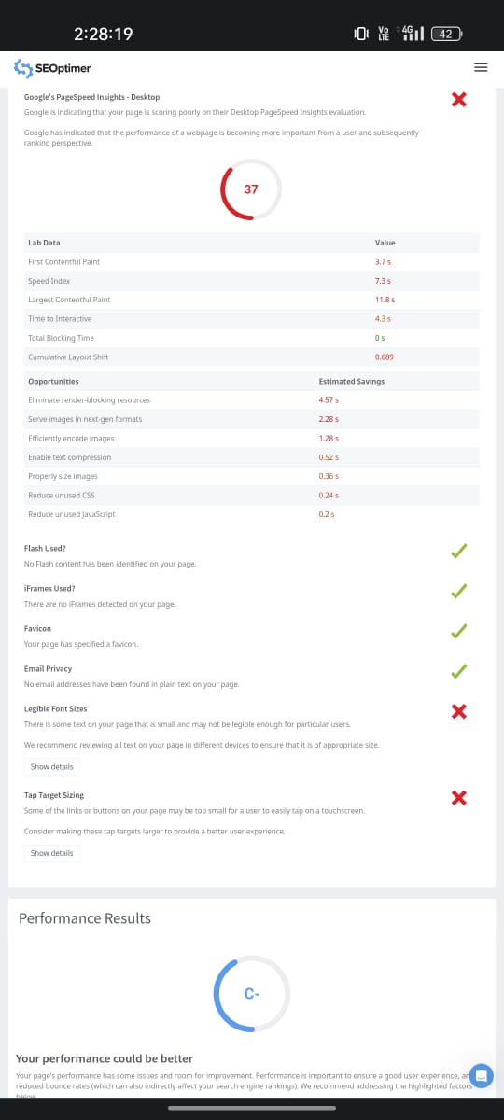
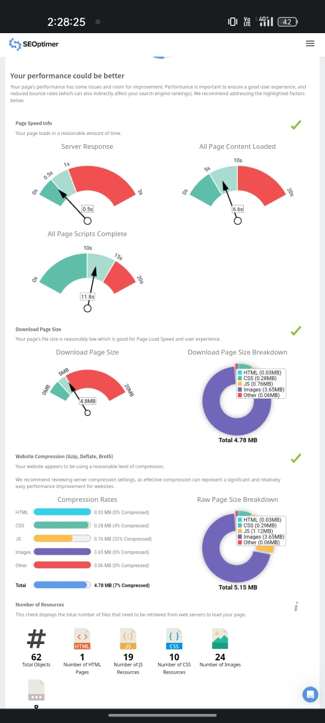

Slide 11
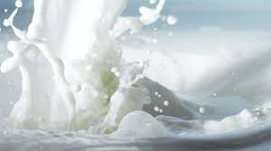
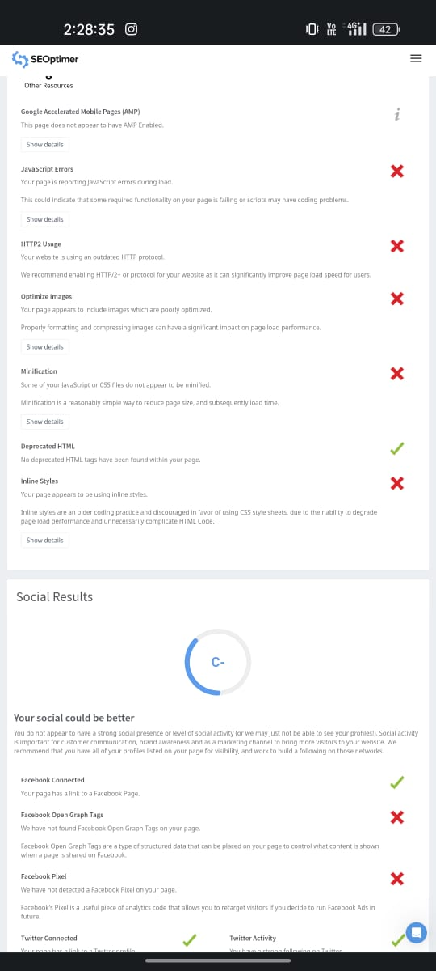
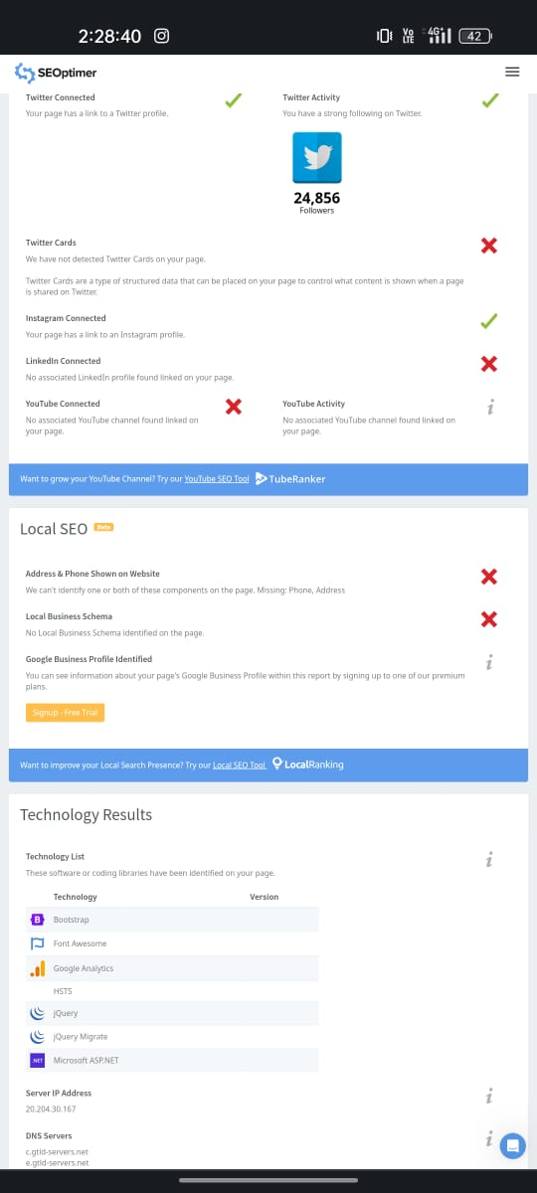
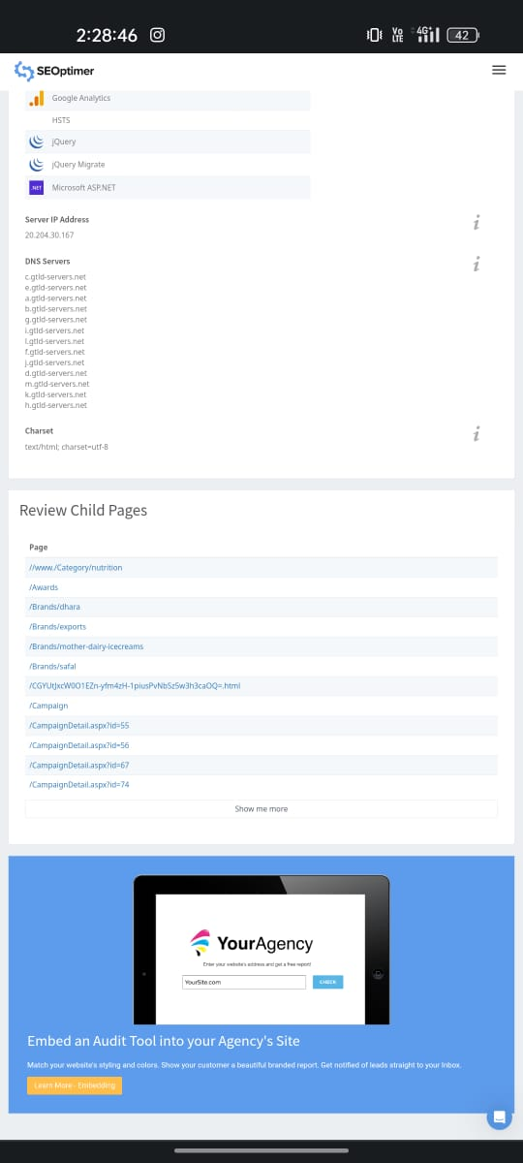

Slide 12
KEY WORD RESEARCH:-
KEY WORD | VOLUME | COMPITETION | KEI
MOTHER DAIRY | 660 | 29 | 77
DAIRY CALVS TAKEN FROM MOTHER DAIRY | 230 | - | -
MOTHER DIRY CANAD | 100 | - | -
MOTHER DAIRY SHARE PRICE | 90 | - | -
AMBER LYNN BACH MOTHER DAIRES | 80 | - | -
DAIRY GOD MOTHER | 80 | - | -
JOB IN MOTHER DAIRY COMPANY | 70 | - | -
BREET FEED BABY MILM ALLERGY | 70 | - | -
DAIRY FREE MOTHER REFLUX BABY | 70 | - | -
MOTHER DAIRY AAM DOI ONLINE | 70 | - | -

Slide 13
KEY WORD | VOLUME | COMPETITION | KEI
Dairy cows good mothers | 55 | - | -
Dairy queen mothers day ice cream | 55 | - | -
Dairy queen mothers day cake | 55 | - | -
Mothers day india reliablw | 55 | - | -
Mother dairy misti doi | 55 | - | -
Mother dairy probotic dahi | 55 | - | -
Mothers dairy | 55 | - | -
Mothers dairy cheese | 50 | - | -
Mothers dairy | 50 | - | -
Mothers dairy contact | 50 | - | -

Slide 14
CONTENT IDEA AND GENERATION :
SUNDAY | MONDAY | TUESDAY | WEDNESDAY | THURSDAY | FRIDAY | SATURDAY
 |  |  |  | 12 | 13 | 14
 |  |  |  | Marketing meeting | Breifing about targeting sales | Connecting with customers
 |  |  |  | webinar
15 | 16 | 17 | 18 | 19 | 20 | 21
 | Campaign | New blogs | Instagram chat | Group engagement | E-Book | Campaign
22 | 23 | 24 | 25 | 26 | 27 | 28
 | Holiday | Holiday | Holiday | Facebook | Twitter promotion
 |  |  |  |  |  | Product launch
29 | 30 | 31
 | Twitter chat | others

Slide 15

MOTHER DAIRY POSTERS:-

Slide 16
INSTAGRAM REEL:- https://instagram.com/stories/durga00089/3212621732783686286?utm_source=ig_story_item_share&igshid=MTc4MmM1YmI2Ng==

Slide 17
Team Contribution:-
Me and my team had done a power point presentation on Mother Dairy .In my team we have divided the work equally, so now I will explain about how we divided the project and how we all participated as a part of team. We are providing this informatIon in certain social network ,blogs and some other mediums of promotions that is
(1) Srivardhan.Beri ( Team leader ) :-
(A)Research brand and mission values
(B) Mother Dairy (Unique selling preposition
(C) Smart goals and KPI’S.

Slide 18

(2) Seepana durgaprasad:- (A) BUYER’S/AUDIENCE PERSONA (B) Competitor analysis (C) SEO Audit (3) Podugu Charan:- (A)SEO AUDIT (B) SEO AUDIT (C) SEO AUDIT

Slide 19

(4)Althi sai prasanna:- (a) SEO AUDIT (b) KEY WORD RE SEARCH (c) KEY WORD RESEARCH (5) Gandham padmaja (a) CONTENT IDEA GENARATION (b) POSTER (c) MOTER DAIRY REEL

Slide 20



